Slide 1
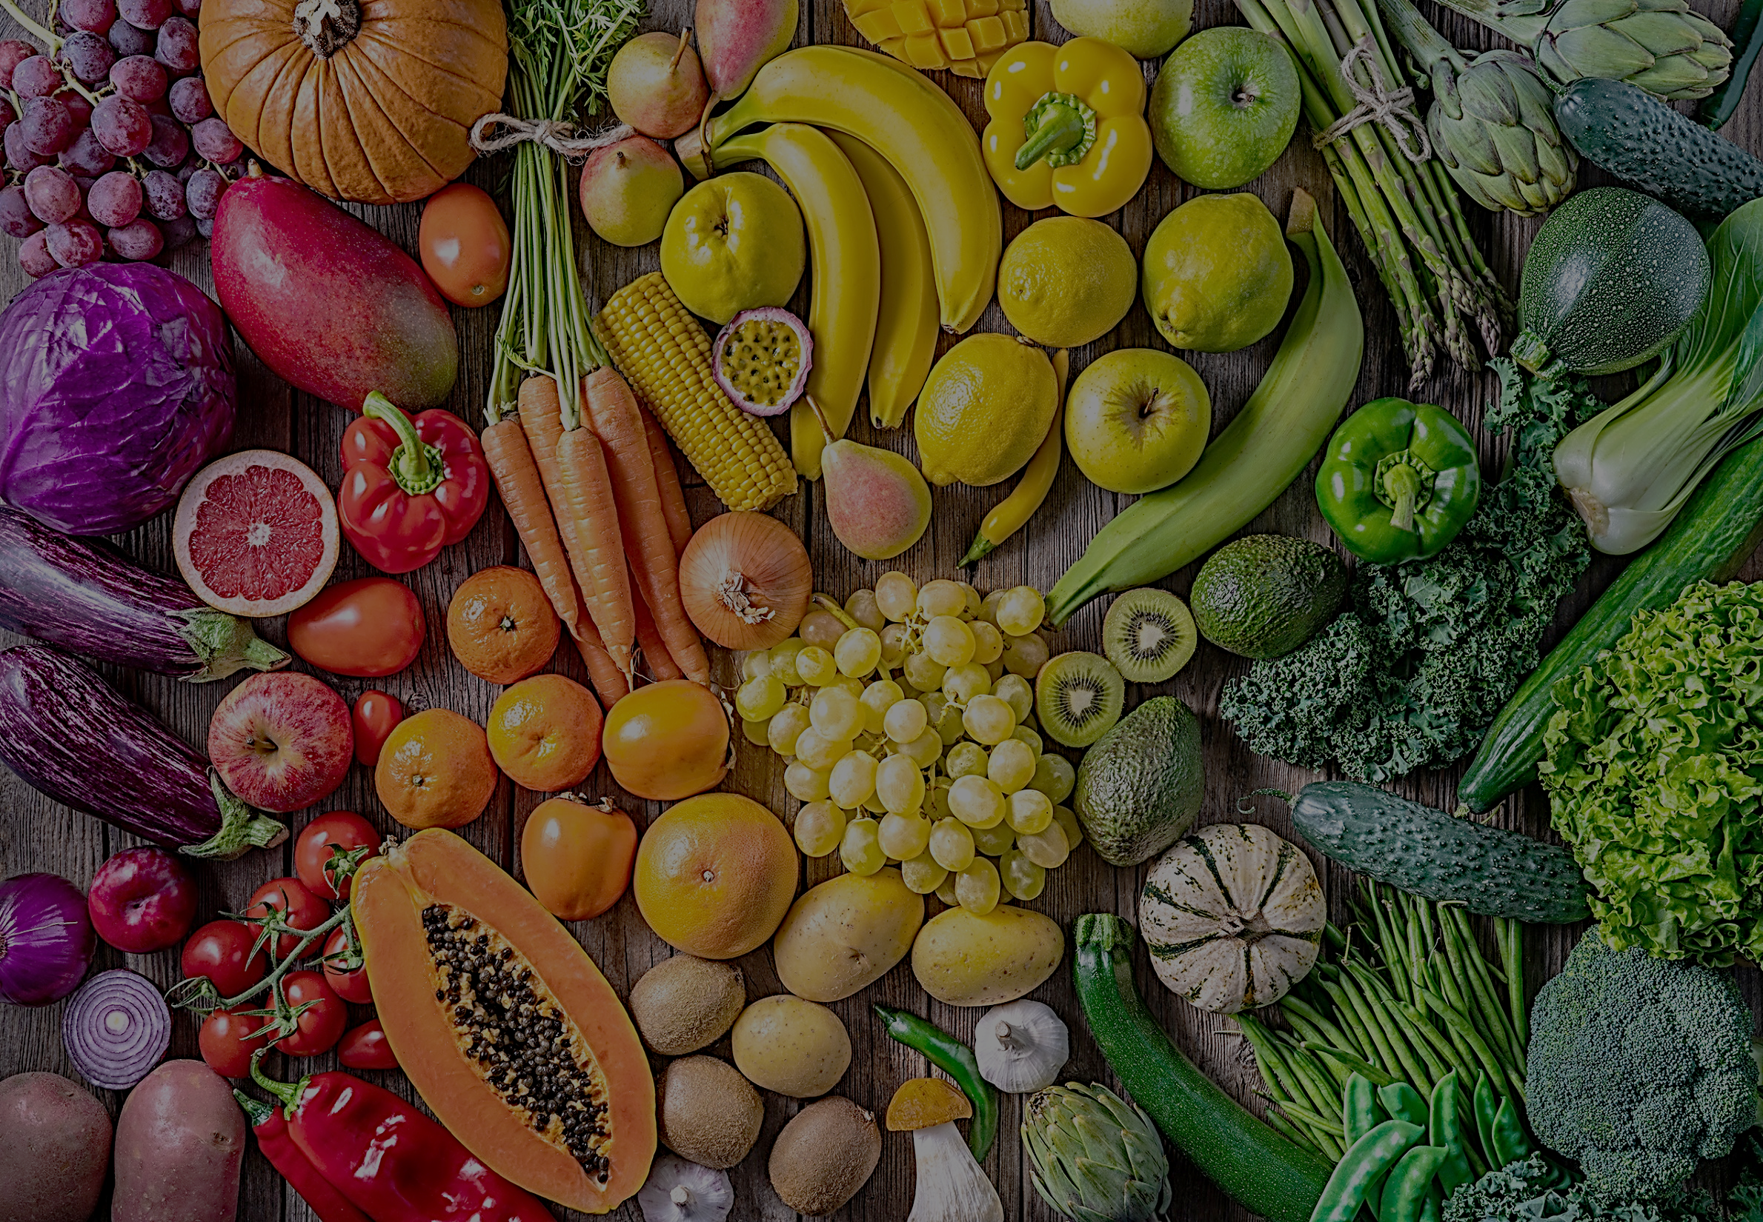


Week 1 | Monday | Tuesday | Wednesday | Thursday | Friday
Meat Main | Cheeseburger with Jacket Wedges & Sweetcorn | Peri Peri Chicken Wrap | Chicken Katsu Curry with Basmati Rice & Mixed Vegetables | Beef Lasagne with Garlic Bread & Broccoli Side Salad | Chip Shop Friday
Vegetarian Main | Vegi Burger with Jacket Wedges & Sweetcorn | Spicy Mexican Bean Wrap | Vegetable Korma with Basmati Rice & Mixed Vegetables | Roasted Vegetable & Feta Lasagne with Garlic Bread & Broccoli Side Salad | Cheese & Onion Pasty
Dessert of the Day | Apple & Berry Crumble Custard Yogurt, Fresh Cut Fruit, Fruit Pot, Jelly | Syrup Sponge Custard Yogurt, Fresh Cut Fruit, Fruit Pot, Jelly | Chocolate Sponge Chocolate Sauce Yogurt, Fresh Cut Fruit, Fruit Pot, Jelly | Rice Pudding with Jam Yogurt, Fresh Cut Fruit, Fruit Pot, Jelly | Cake Selection Yogurt, Fresh Cut Fruit, Fruit Pot, Jelly
Pasta & Jackets | Pasta Bar with Sauces Jacket Potatoes Available daily | Pasta Bar with Sauces Jacket Potatoes Available daily | Pasta Bar with Sauces Jacket Potatoes Available daily | Pasta Bar with Sauces Jacket Potatoes Available daily | Pasta Bar with Sauces Jacket Potatoes Available daily
Grab ‘n’ Go | Assorted Grab & Go Items Available Daily | Assorted Grab & Go Items Available Daily | Assorted Grab & Go Items Available Daily | Assorted Grab & Go Items Available Daily | Assorted Grab & Go Items Available Daily
Please ask for more information if you have allergies.

Slide 2
Week 2 | Monday | Tuesday | Wednesday | Thursday | Friday
Meat Main | Chicken Tikka Masala with Basmati Rice Peas | Taco Tuesday | Southern Coated Chicken Burger with Wedges & Sweetcorn | Sausage & Mash with Peas & Gravy | Chip Shop Friday
Vegetarian Main | Quorn, Spinach & Chickpea Rogan Josh with Basmati Rice | Taco Tuesday | Vegi Quarter Pounder with Wedges & Sweetcorn | Macaroni Cheese with Garlic Bread & Salad | Vegan Sausage Rolls
Dessert of the Day | Cherry Crumble Custard Yogurt, Fresh Cut Fruit, Fruit Pot, Jelly | Jam Sponge Custard Yogurt, Fresh Cut Fruit, Fruit Pot, Jelly | Chocolate Brownie Chocolate Sauce Yogurt, Fresh Cut Fruit, Fruit Pot, Jelly | Pancakes & Syrup Yogurt, Fresh Cut Fruit, Fruit Pot, Jelly | Cake Selection Yogurt, Fresh Cut Fruit, Fruit Pot, Jelly
Pasta & Jackets | Pasta Bar with Sauces Jacket Potatoes Available daily | Pasta Bar with Sauces Jacket Potatoes Available daily | Pasta Bar with Sauces Jacket Potatoes Available daily | Pasta Bar with Sauces Jacket Potatoes Available daily | Pasta Bar with Sauces Jacket Potatoes Available daily
Grab ‘n’ Go | Assorted Grab & Go Items Available Daily | Assorted Grab & Go Items Available Daily | Assorted Grab & Go Items Available Daily | Assorted Grab & Go Items Available Daily | Assorted Grab & Go Items Available Daily
Please ask for more information if you have allergies.

Slide 3

Week 3 | Monday | Tuesday | Wednesday | Thursday | Friday
Meat Main | Beef Chilli with Rice & Sour Cream Side Salad | Teriyaki Chicken Noodles Mixed Vegetables | BBQ Chicken Thigh Basmati Rice & Mixed Vegetables | Minced Beef Mozzarella Wrap Side Salad | Chip Shop Friday
Vegetarian Main | Macaroni Cheese with Garlic Bread & Salad | Creamy Spinach & Feta Penne Mixed Vegetables | Vegetable Tikka Masala with Basmati Rice & Mixed Vegetables | Roasted Vegetable Feta Wrap Side Salad | Vegetable Nuggets
Dessert of the Day | Pear Crumble Custard Yogurt, Fresh Cut Fruit, Fruit Pot, Jelly | Vanilla Sponge Custard Yogurt, Fresh Cut Fruit, Fruit Pot, Jelly | Churros with Chocolate Sauce Yogurt, Fresh Cut Fruit, Fruit Pot, Jelly | Apple Pie & Custard Yogurt, Fresh Cut Fruit, Fruit Pot, Jelly | Cake Selection Yogurt, FreshCcut Fruit, Fruit Pot, Jelly
Pasta & Jackets | Pasta Bar with Sauces Jacket Potatoes Available daily | Pasta Bar with Sauces Jacket Potatoes Available daily | Pasta Bar with Sauces Jacket Potatoes Available daily | Pasta Bar with Sauces Jacket Potatoes Available daily | Pasta Bar with Sauces Jacket Potatoes Available daily
Grab ‘n’ Go | Assorted Grab & Go Items Available Daily | Assorted Grab & Go Items Available Daily | Assorted Grab & Go Items Available Daily | Assorted Grab & Go Items Available Daily | Assorted Grab & Go Items Available Daily
Please ask for more information if you have allergies.

