Slide 1

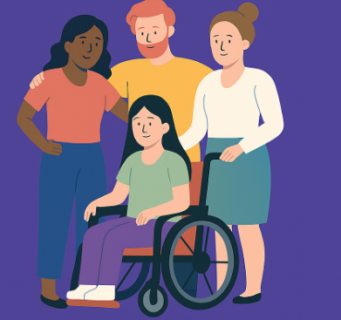
Other Curriculum areas.
Here are some of the other things we are covering this Term:
History – Identifying and Naming People Who Helped Us in the Past
We will explore significant people from the past who helped others in their communities. The lesson will be highly visual, using a range of images to support learning. Children will be encouraged to match pictures of these individuals with their names and contributions, helping to develop both recognition and understanding.
Science: We are learning about the body parts through engaging games and activities.
:computing – being safe
trust and relationships
PSHE: Healthy Relationships - Building trust, understanding boundaries and managing emotions in relationships.
Art: We are exploring various textures and facial expressions. We will create portraits of people who make a difference.
We will be working hard to be independent and to complete some of our daily routines on our own and to tell/show adults how I am feeling and what I need to self-regulate.
Stories and Themes we are Learning from:
‘Owl Babies by Martin Waddell a beloved picture book by Martin Waddell, illustrated by Patrick Benson. It tells the gentle, reassuring story of three baby owls—Sarah, Percy, and Bill—who wake up one night to find their mother gone.
People who make difference
Autumn- Term 1
Birch Class
English and Phonics
Communication: Pupils will be responding to simple questions supported by visual communication aids and choosing boards. During our activities pupils will work in small groups, turn taking and making simple requests.
Writing: We’re all about sharing ideas in every way we can — using all kinds of tools and ways to communicate, so everyone can join in and be heard.
Phonics sessions are taken on a one to one basis following individual needs
Highlights
We are getting know each other trough our RSE lessons.
Maths
Our main focus for this term is on:
Rote counting
Quantities
Numbers
How you can help at home.
Home Learning:
Please explore our stories and themes of the term. You may have a copies of the stories we are using to teach from this term. Reading this at home or letting your child tell you/point out favourite parts of the story is a great way to link school learning with home learning.
We are learning how to identify our emotions and how to cope with them, see if your child can use some of these at home.

